Slide 1
Intelligent Financial Reporting System
By – Bhavik Vora
Charishma Seenappa
Deepti Pundlik
Juilee Jadhav
Prarthana Angadi

Slide 2
Problem Statement
With the steady increase in the financial data it’s essential that we have a precise, reliable & intelligent system which consolidates the data gathered from financial bodies, structures them into a standard format.
This can be useful to all the firms in representing its financial invoices on the same basis as its foreign competitors, making comparisons easier. Implementation of this system will give the liberty to all the financial bodies to setup & follow their own standards.

Slide 3
The ability to disseminate information from multiple sources is the need of the hour. Different firms around the world are following a different formats .Our system will prove to be helpful in allowing the firms
Collect data/invoice from different financial resources.
Provides a seed data for invoices.
Populate, map and analyze the data
Retrieve the formatted data
Deliver the formatted report

Slide 4
Project Flow
Database
Collect data/report from different financial resources
Provide a seed data for financial reports
Intelligent System/Machine Learning System
Populate, map and analyze the data
Retrieve the formatted data
Deliver the formatted report

Slide 5
Collection Of Data
Data collected is invoice which contains invoice details, sender details, customer details in XML Format.
The data is preprocessed and imported into the MYSQL database.
Preprocessing: Java Code.
Pattern matching has been used in Store Procedures.
Assumption-Header tag will be the first tag and invoice number will be the first tag under the header tag.

Slide 6
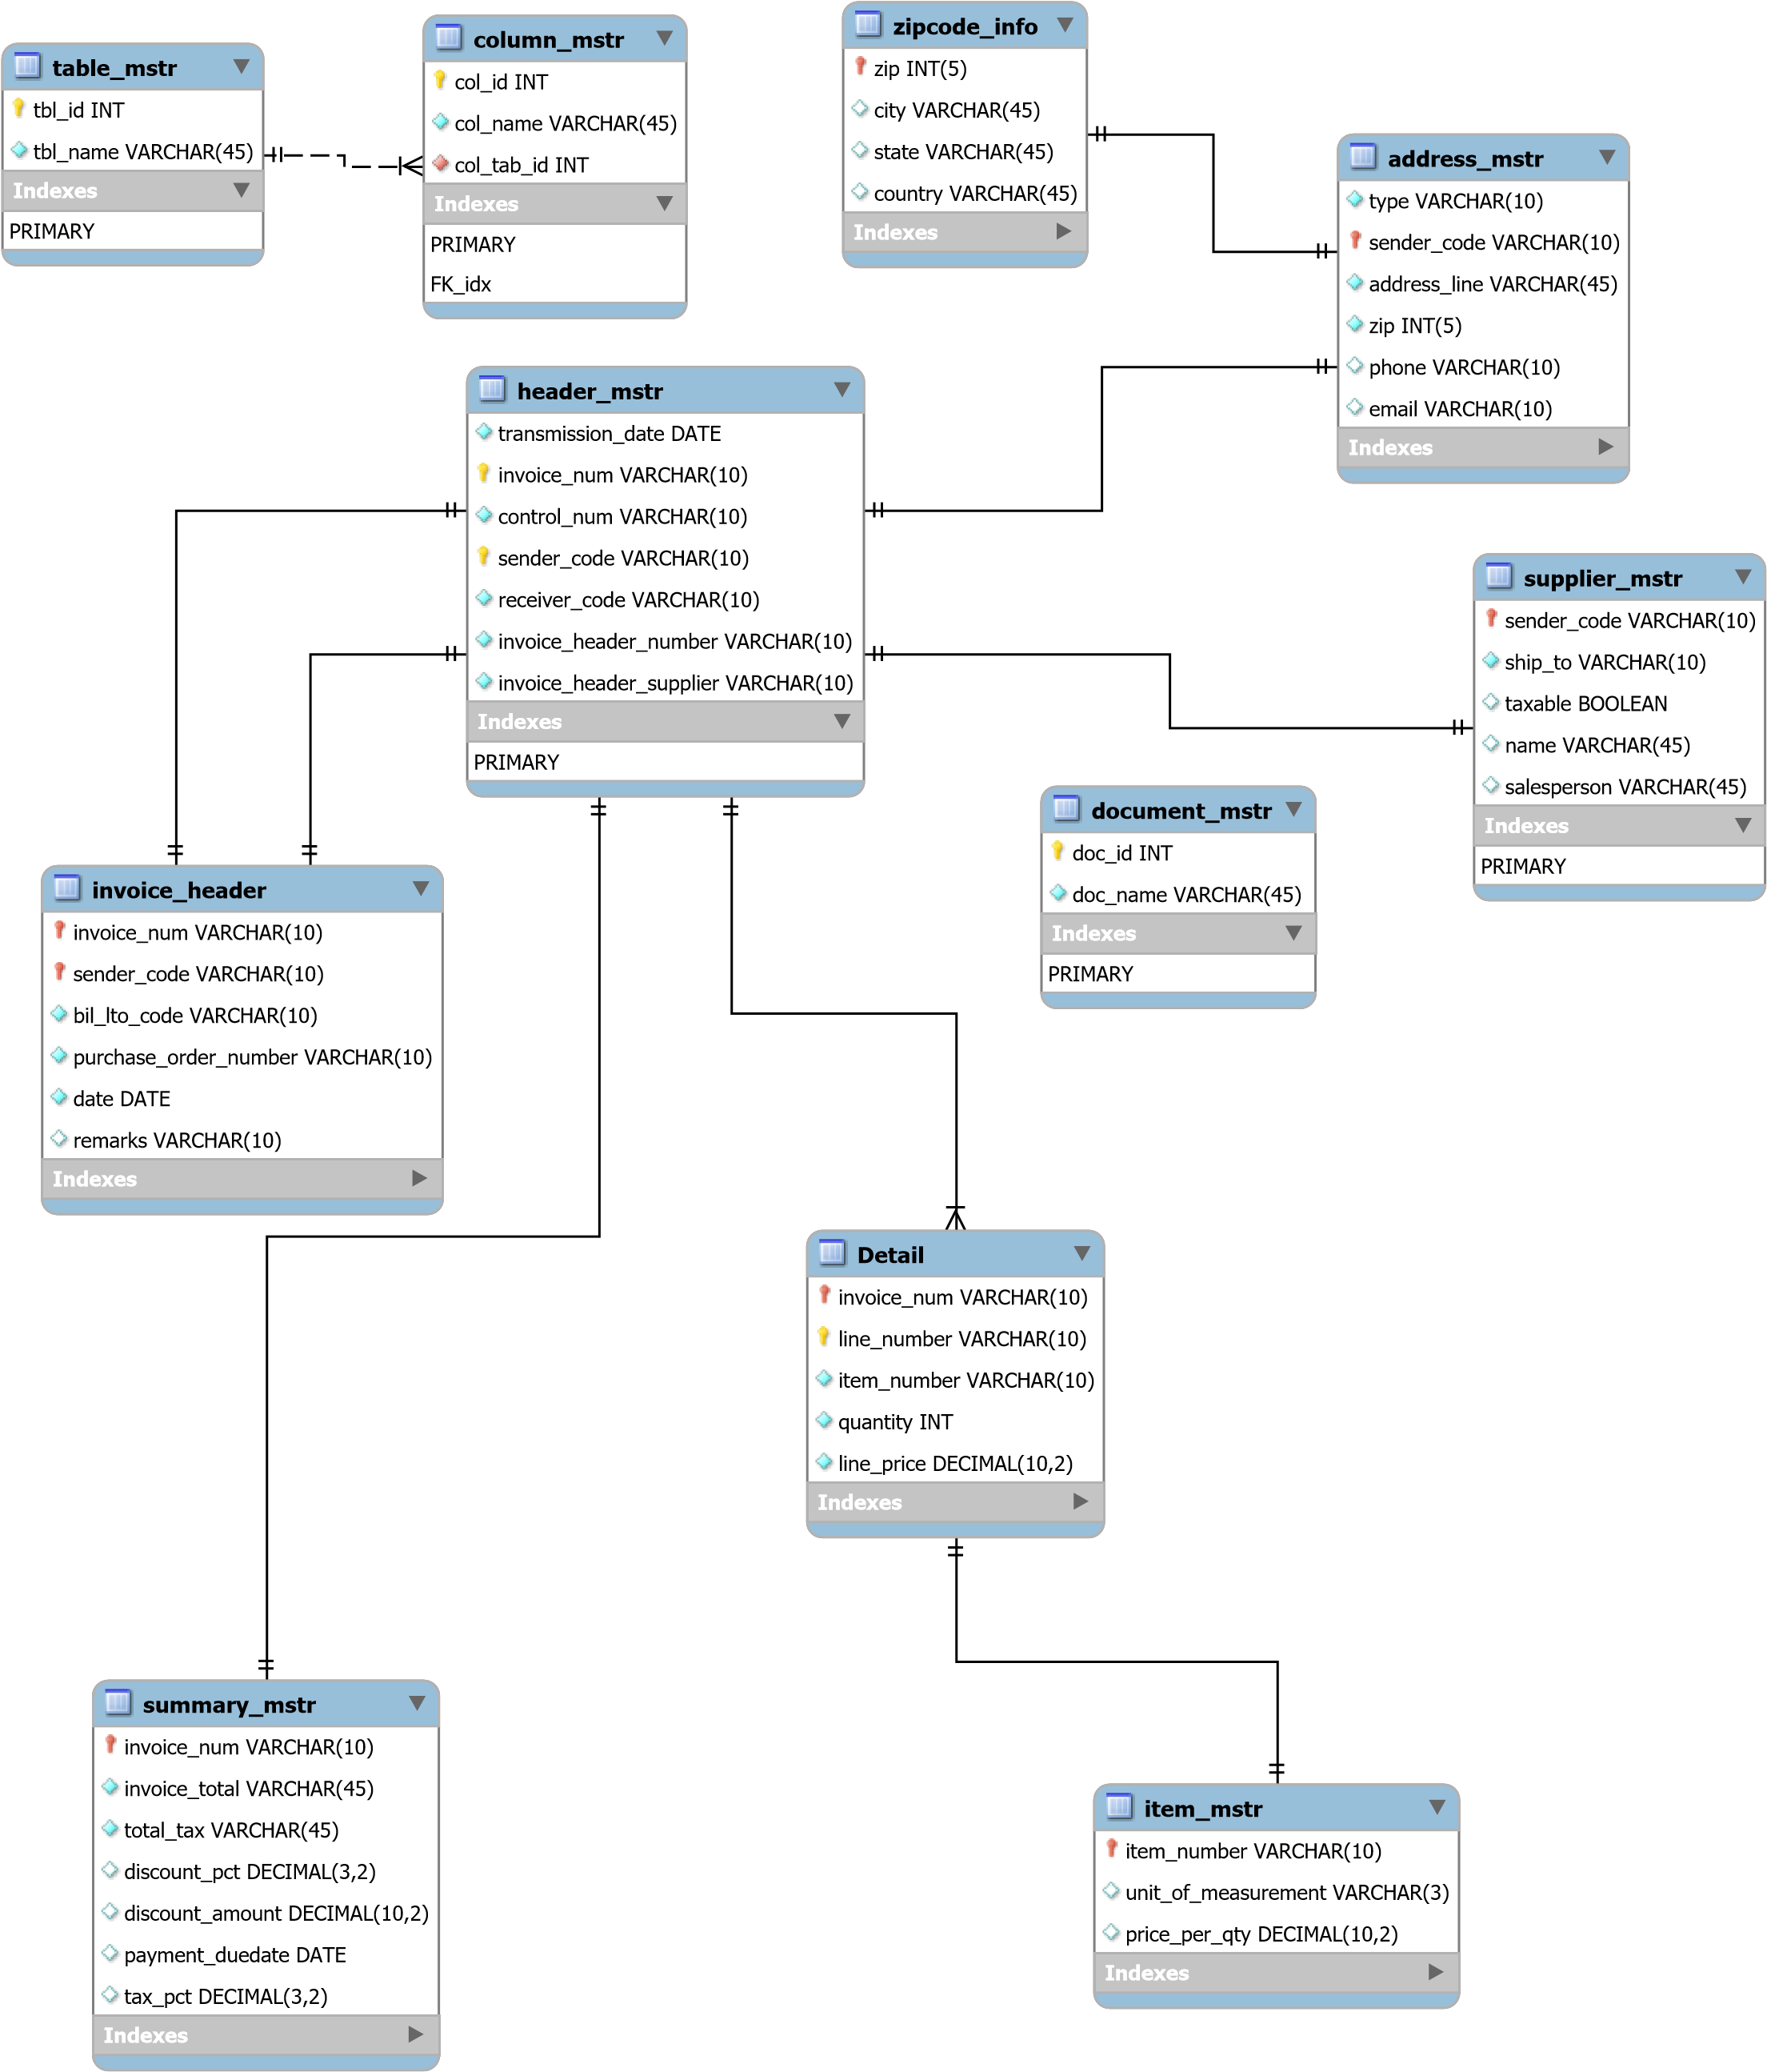
ER Diagram

Slide 7




pics

Slide 8
Thank You

